Slide 1
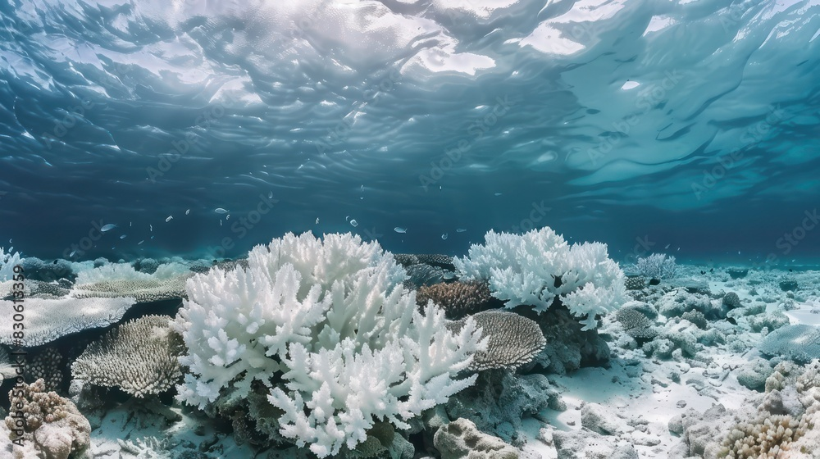
Coral Reef Health
August 2025
Miranda McMurray

Slide 2
Index
PORTFOLIO
Problem Explanation
Data Collection
Design Agency Name
Data Wrangling
EDA
#
01
02
03
04

Slide 3
Index
PORTFOLIO
Modeling
Results
Design Agency Name
Recommendation
Future Steps
#
01
02
03
04

Slide 4
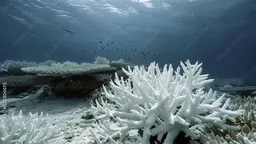
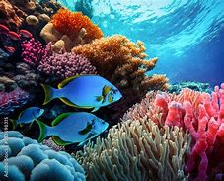
Problem Statement
This project aims to identify the possible contributors to our dying coral reefs from human pollution sources.
Bleaching Reefs
Healthy Coral Reef

Slide 5
Data Collection
Coral reef health indicators, pollutants and their sources, and HDI (human development index) data was collected from reputable sources. This enabled us to make models predicting bleaching on these global variables.
Data
Sources
HDI
Global Pollution levels
Coral reef health
UNDP at Human Development Index | Human Development Reports
EDGAR at EDGAR - The Emissions Database for Global Atmospheric Research
BCO-DMO at https://www.bco-dmo.org/

Slide 6
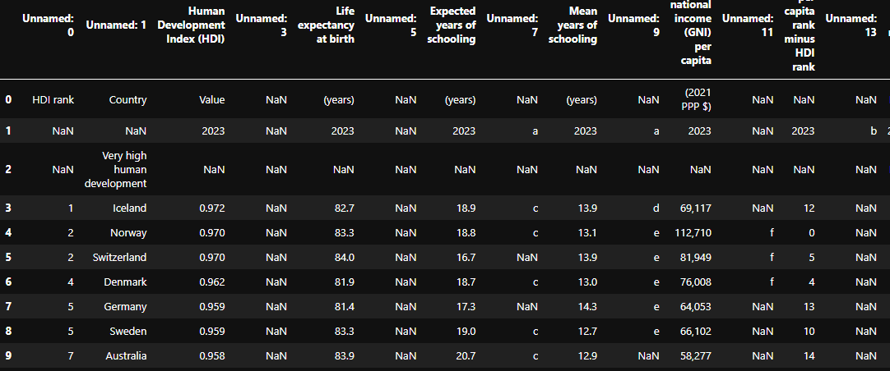
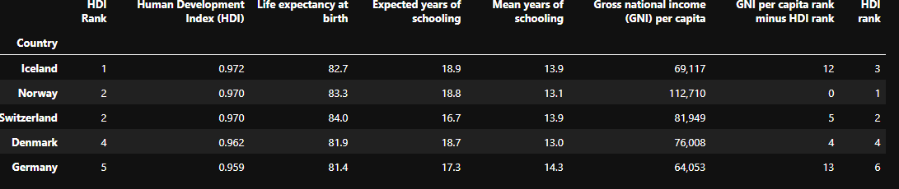
Data Wrangling
Data Preparation
Thankfully, most of the data was pretty clean upon download. Removal of unnecessary columns and rows (insufficient entries) was done during this step. * columns and 4 rows were removed.
HDI starting point
Final format of the dataset

Slide 7

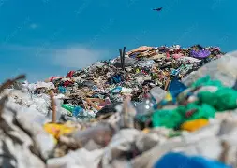
Data Wrangling
Pollution Data
Types and Sources
The pollution data is global in scale Initially, I tried doing country based pollution levels, but the amount of data was simply too large to manage effectively. These values are separated by pollution source and key pollutants.
Pollutants: Hg (mercury) , NOx (nitrogen oxides), SO2 (sulfur dioxide), organic carbon, PM10 (particulate matter)
Sources: waste, power industry, transportation, agriculture, construction, and other

Slide 8
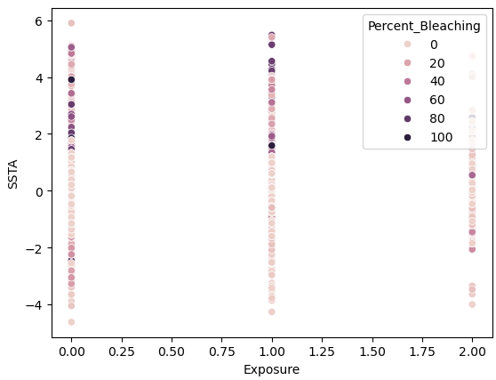
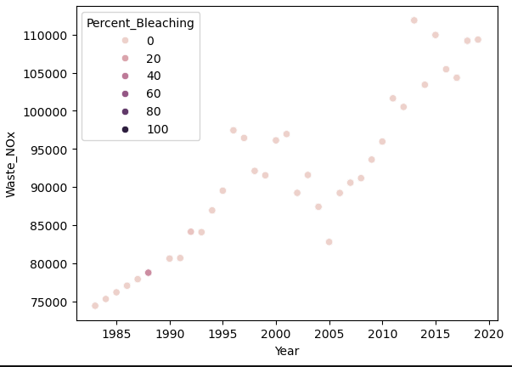
Exploratory Data Analysis
Data Exploration
Originally, I believed that pollutants would be the main indicators of coral reef health, but the data showed that climate variability was more effective in determining bleaching. Climate variability can be a result of increased global pollution levels.
Coral Reef expose and temperature variability
NOx levels over the years

Slide 9
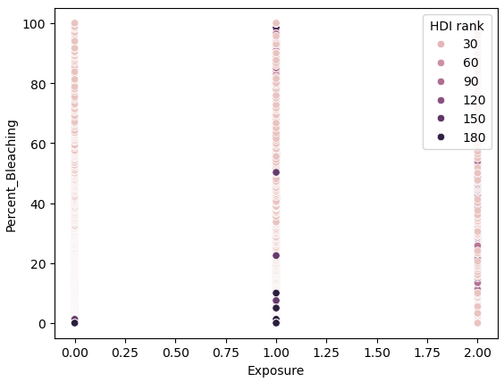
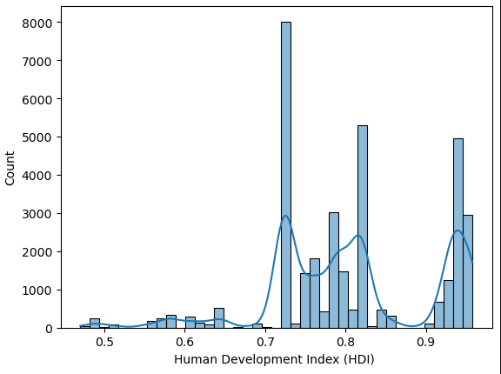
Exploratory Data Analysis
This graph shows the percentage of coral reef bleaching by exposure levels. The color intensity is based on HDI level of the region. Lower bleaching percentages are associated with countries with lower ranking
Most countries have an HDI rating of 0.75 or higher.

Slide 10
Modeling
First Models
All categorical features for this project were encoded, making them numeric. Everything was scaled for model efficiency and to ensure no feature dominates another simply for having larger values (temperature (K) was higher values than turbidity). Linear regression alone offered little in prediction power, but regression models and neural networks worked very well.
Model 1: Linear Regression
R Squared: 0.32-0.34
MAE: 9.4-9.8
Notes: Linear regression was a baseline model. Our target value, ‘Percent_Bleaching’, is skewed towards lower values but there are outliers in the 80-100 percent range.
Model 2: MLPRegressor
R Squared: 0.58-0.59
MAE: 5-6
Notes: Using a neural network with 3 layers showed substantial gains in predictability. Hyper parameter tuning provided marginal improvements, leading to other models being explored.
Model 3: SVR
R Squared: 0.26-0.38
MAE: 7
Notes: Theoretically, SVR would have been a great model as it is less sensitive to outliers and can work better with complex data. The r squared score was low, but it still was able to predict our target within 7 percentage points.

Slide 11
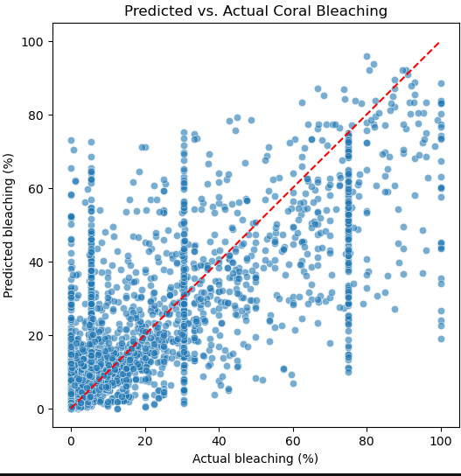
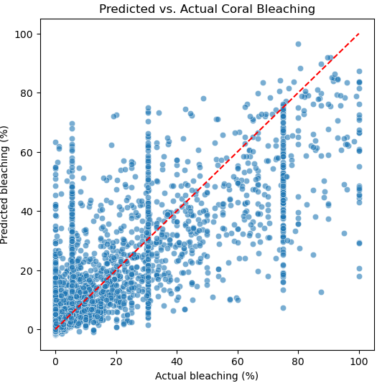
Modeling
Model 4: Random Forest
Model 5: Stacked
R Squared : 0.68-0.69
MAE: 4-5
Notes: The Random Forest Regressor performs well at predicting lower bleaching percentages but consistently underestimates higher bleaching values, indicating underfitting at the upper range.
R Squared: 0.69
MAE: 5
Notes: The stacked model shows similar patterns to the Random Forest model, predicting lower bleaching percentages but underfits higher values. This model was consisted of the Random Forest model, XGBoost, lgb, MLPRegressor, and had linear regression as the meta model.

Slide 12
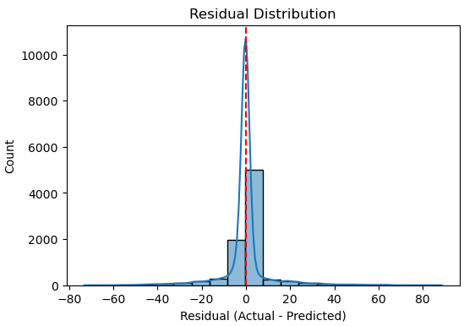
Results
Winning model
Random Forest and the stacked model performed very similarly. Random Forest had a slightly better MAE, predicting bleaching percentages up to one percent more accurately than the stacked model. For this reason, Random Forest was the best model in this project.
The residuals lie to the right of the red line, indicating the model underestimates the higher target values.

Slide 13
Recommendations
Coral Reef Health is dependent on our efforts now.
Model use
Continue to improve model accuracy (above 0.6 R squared is considered good for ecological data)
Expand model to predict future bleaching from current pollution ratings
Predict which countries contribute the most to declining coral reef health using GIS data

Slide 14
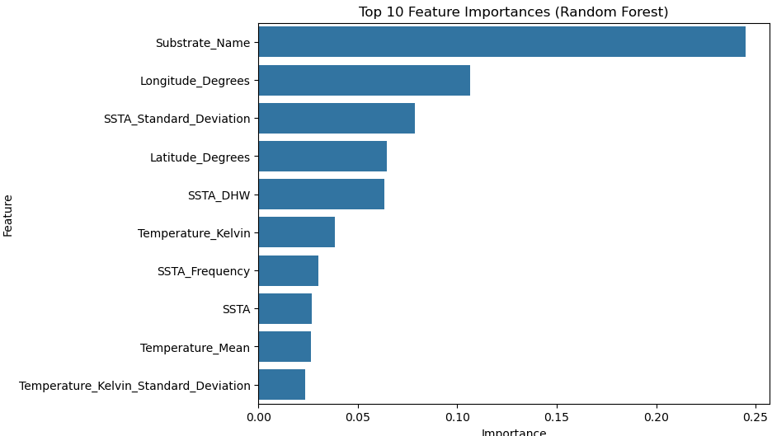
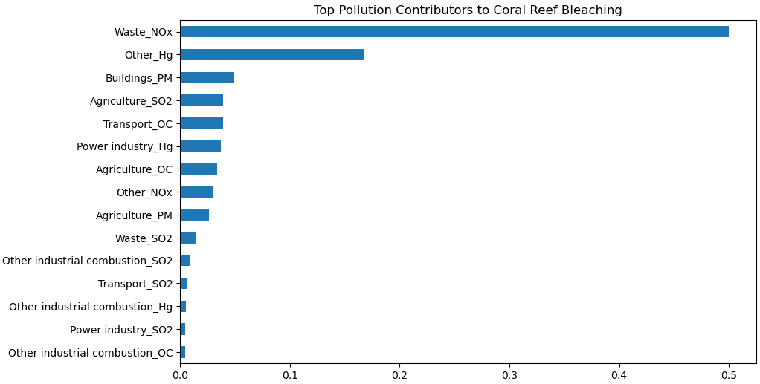
Future Steps
Future Project Exploration:
We need to continue to explore the relationships between our important features and the bleaching of the coral reefs. Our key features are direct indicators of climate changes within the region. SSTA contributing more to bleaching than higher temperatures alone show that climate volatility impacts coral health more than sustained warming.
Features
Pollution Importance

Slide 15
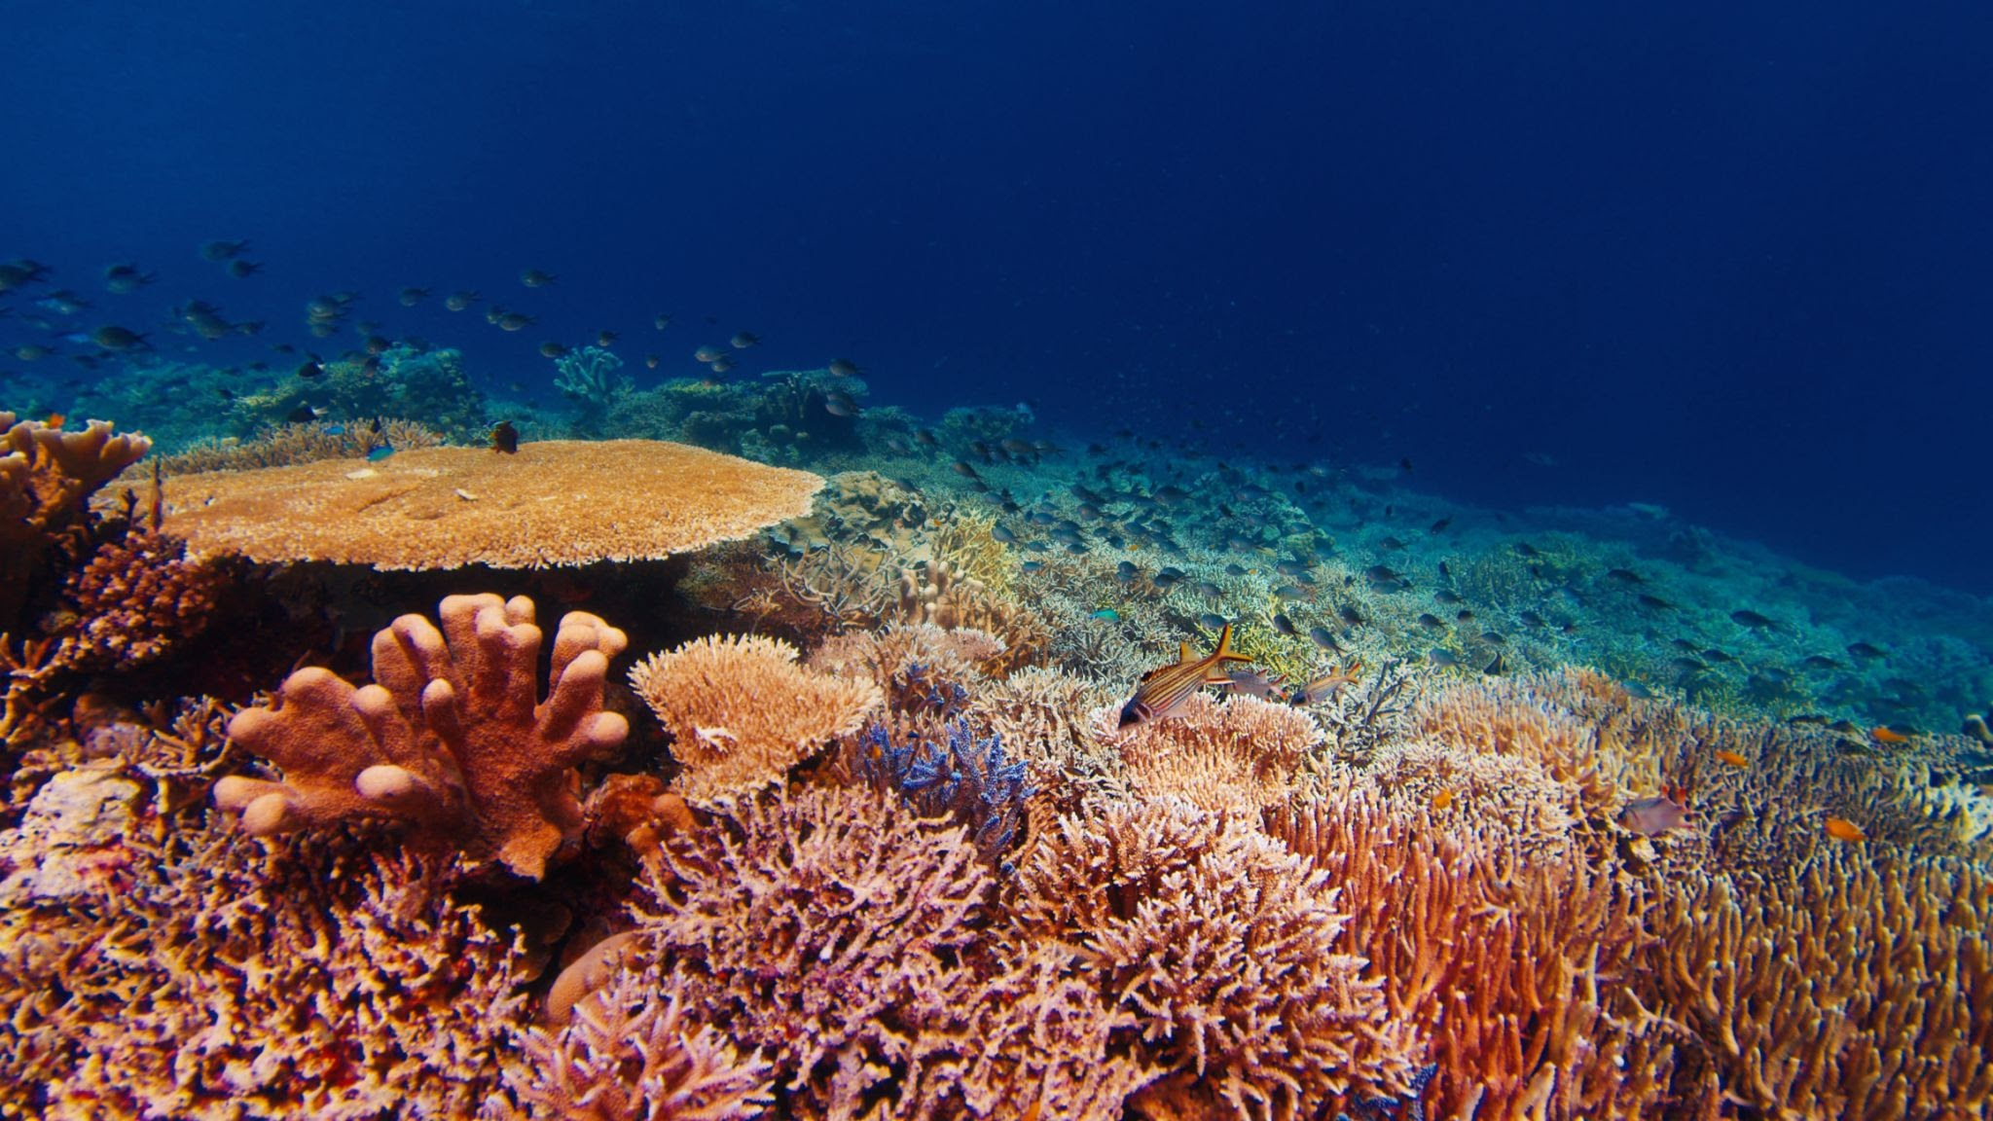
Thank you!

